Slide 1




Computer Networks
Application Layer Services and Protocols
Lecturer: Sura F. Ismail
Lecture Four.
Second Class.
Time: 9: 30- 11:30
Department: Informatics Systems Management (ISM)

Slide 2
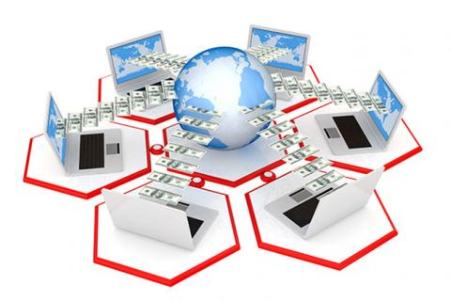
Outline
Outline
Overview
DNS Services and Protocol
WWW Service and HTTP
E-Mail Services and SMTP/POP Protocols
FTP
DHCP
Telnet Services and Protocol
6. Trends in Networking

Slide 3
1. Overview
Outline
Now that you have a better understanding of how applications provide an interface for the user and provide access to the network, you will take a look at some specific commonly used protocols.
The transport layer uses an addressing scheme called a port number. Port numbers identify applications and application layer services that are the source and destination of data. Server programs generally use predefined port numbers that are commonly known by clients.
Some of these services are
Domain Name System (DNS): TCP/UDP port 53
HTTP: TCP port 80
Simple Mail Transfer Protocol (SMTP): TCP port 25
Post Office Protocol (POP): UDP port 110
Telnet: TCP port 23
DHCP: UDP port 67
FTP: TCP ports 20 and 21

Slide 4
2. DNS Services and Protocol
Outline
In data networks, devices are assigned IP addresses so that they can participate in sending and receiving messages over the network. However, most people have a hard time remembering this numeric address. Hence, domain names were created to convert the numeric address into a simple, recognizable name.
On the Internet, these domain names, such as http://www.cisco.com, are much easier for people to remember than 198.132.219.25, which, at the time of this writing, is the numeric address for this server.
When networks were small, it was a simple task to maintain the mapping between domain names and the addresses they represented. However, as networks began to grow and the number of devices increased, this manual system became unworkable.
DNS was created for domain name–to–address resolution for these networks. DNS uses a distributed set of servers to resolve the names associated with these numbered addresses.

Slide 5
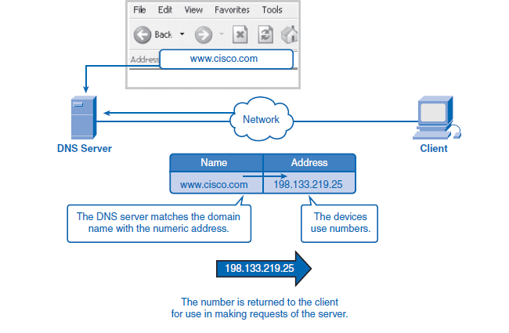
2. DNS Services and Protocol
Outline

Slide 6
2. DNS Services and Protocol
Outline
How DNS Works
The DNS protocol defines an automated service that matches resource names with the required numeric network address. It includes the format for queries, responses, and data formats. DNS protocol communications use a single format called a message. This message format is used for all types of client queries and server responses, error messages, and the transfer of resource record information between servers.
DNS is a client/server service; however, it differs from the other client/server services that you are examining. Whereas other services use a client that is an application (web browser, e-mail client, and so on), the DNS client runs as a service itself. The DNS client, sometimes called the DNS resolver, supports name resolution for the other network applications and other services that need it.

Slide 7
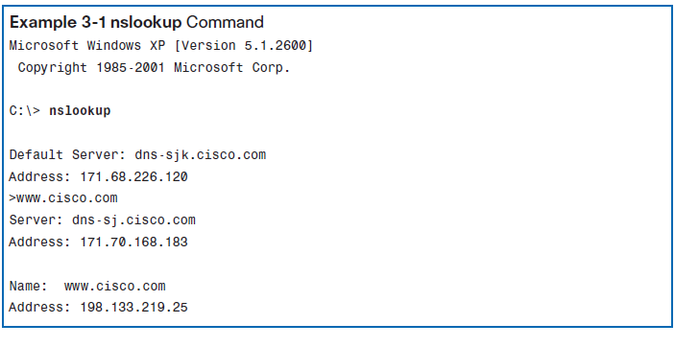
2. DNS Services and Protocol
Outline
When configuring a network device, you generally provide one or more DNS server addresses that the DNS client can use for name resolution.
Computer operating systems also have a utility called nslookup that allows the user to manually query the name servers to resolve a given host name. You also can use this utility to troubleshoot name resolution issues and to verify the current status of the name servers.

Slide 8
2. DNS Services and Protocol
Outline
Name Resolution and Caching
A DNS server provides the name resolution using the name daemon. The DNS server acts as the phone book for the Internet: It translates human-readable computer host names, for example, http://www.cisco.com, into the IP addresses that networking equipment needs for delivering information.
When a client makes a query, the “named” process first looks at its own records to see whether it can resolve the name. If it is unable to resolve the name using its stored records, it contacts other servers to resolve the name. The request can be passed along to a number of servers, which can take extra time and consume bandwidth. When a match is found and returned to the original requesting server, the server temporarily stores the numbered address that matches the name in the cache.
If that same name is requested again, the first server can return the address by using the value stored in its name cache. Caching reduces both the DNS query data network traffic and the workloads of servers higher up the hierarchy.
The DNS client service on Windows PCs optimizes the performance of DNS name resolution by storing previously resolved names in memory, as well. The ipconfig/displaydns command displays all the cached DNS entries on a Windows XP or 2000 computer system.

Slide 9
2. DNS Services and Protocol
Outline
DNS Hierarchy
DNS uses a hierarchical system to create a name database to provide name resolution. The hierarchy looks like an inverted tree with the root at the top and branches below. At the top of the hierarchy, the root servers maintain records about how to reach the top level domain servers, which in turn have records that point to the secondary-level domain servers and so on.
The different top-level domains represent either the type of organization or the country of origin. The following are examples of top-level domains are:
.au: Australia
.co: Colombia
.com: A business or industry
.jp: Japan
.org: A nonprofit organization

Slide 10
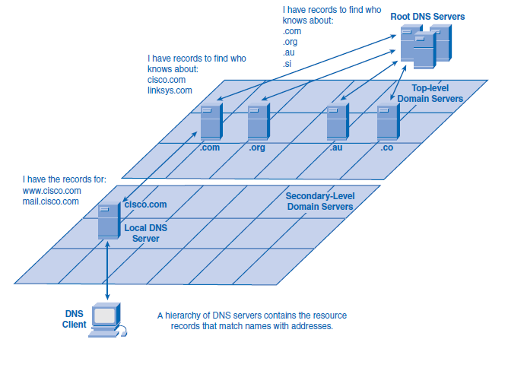
2. DNS Services and Protocol
Outline

Slide 11
3. WWW Service and HTTP
Outline
When a web address (or URL) is typed into a web browser, the web browser establishes a connection to the web service running on the server using HTTP. URLs and URIs (uniform resource identifiers) are the names most people associate with web addresses. The URL http://www.cisco.com/index.html refers to a specific resource—a web page named index.html on a server identified as cisco.com. Web browsers are the client applications computers use to connect to the World Wide Web and access resources stored on a web server. As with most server processes, the web server runs as a background service and makes different types of files available. To access the content, web clients make connections to the server and request the desired resources. The server replies with the resources and, upon receipt, the browser interprets the data and presents it to the user.

Slide 12
3. WWW Service and HTTP
Outline
To better understand how the web browser and web client interact, you can examine how a web page is opened in a browser. For this example, consider the URL http://www.cisco.com/web-server.htm. First, the browser interprets the three parts of the URL:
http: The protocol or scheme
www.cisco.com: The server name
web-server.htm: The specific filename requested
The browser then checks with a name server to convert http://www.cisco.com into a numeric address, which it uses to connect to the server. Using the HTTP requirements, the browser sends a GET request to the server and asks for the file web-server.htm. The server in turn sends the HTML code for this web page to the browser. Finally, the browser deciphers the HTML code and formats the page for the browser window.

Slide 13
3. WWW Service and HTTP
Outline
HTTP specifies a request/response protocol. When a client, typically a web browser, sends a request message to a server, the HTTP protocol defines the message types the client uses to request the web page and the message types the server uses to respond. The three common message types are:
GET
POST
PUT
GET is a client request for data. A web browser sends the GET message to request pages from a web server
POST and PUT are used to send messages that upload data to the web server. For example, when the user enters data into a form embedded in a web page, POST includes the data in the message sent to the server. PUT uploads resources or content to the web server.

Slide 14
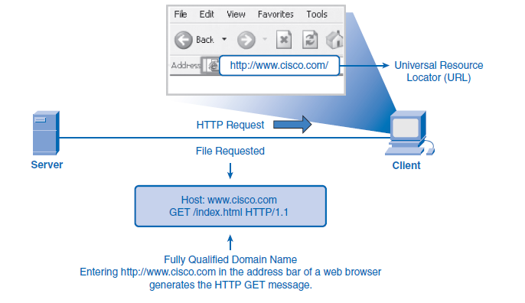
3. WWW Service and HTTP
Outline
Although it is remarkably flexible, HTTP is not a secure protocol. The POST messages upload information to the server in plain text that can be intercepted and read. Similarly, the server responses, typically HTML pages, are unencrypted. For secure communication across the Internet, the Secure HTTP (HTTPS) protocol is used for accessing and posting web server information. HTTPS can use authentication and encryption to secure data as it travels between the client and server. HTTPS specifies additional rules for passing data between the application layer and the transport layer.

Slide 15
4. E-Mail Services and SMTP/POP Protocols
Outline
E-mail, the most popular network service, has revolutionized how people communicate through its simplicity and speed. Yet to run on a computer or other end device, e-mail requires several applications and services. Two examples of application layer protocols are Post Office Protocol (POP) and Simple Mail Transfer Protocol (SMTP). As with HTTP, these protocols define client/server processes. POP and POP3 (Post Office Protocol, version 3) are inbound mail delivery protocols and are typical client/server protocols. They deliver e-mail from the e-mail server to the client (MUA).
SMTP, on the other hand, governs the transfer of outbound e-mail from the sending client to the e-mail server (MDA), as well as the transport of e-mail between e-mail servers (MTA).
SMTP enables e-mail to be transported across data networks between different types of server and client software and makes e-mail exchange over the Internet possible.

Slide 16
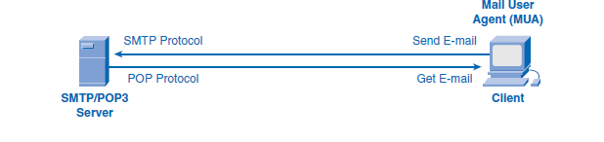
4. E-Mail Services and SMTP/POP Protocols
Outline
When people compose e-mail messages, they typically use an application called a Mail User Agent (MUA), or e-mail client. The MUA allows messages to be sent and places received messages into the client mailbox, both of which are distinct processes.
To receive e-mail messages from an e-mail server, the e-mail client can use POP. Sending e-mail from either a client or a server uses message formats and command strings defined by the SMTP protocol. Usually an e-mail client provides the functionality of both protocols within one application.

Slide 17
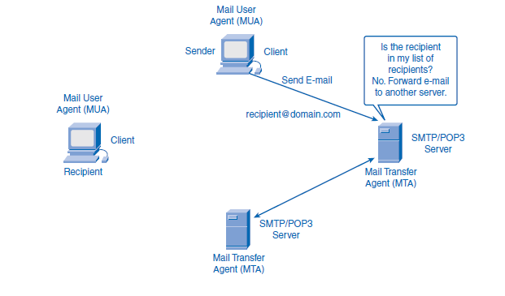
4. E-Mail Services and SMTP/POP Protocols
Outline
E-Mail Server Processes: MTA and MDA
The e-mail server operates two separate processes:
Mail Transfer Agent (MTA)
Mail Delivery Agent (MDA)
The Mail Transfer Agent (MTA) process is used to forward e-mail. The MTA receives messages from the MUA or from another MTA on another e-mail server. Based on the message header, it determines how a message has to be forwarded to reach its destination. If the mail is addressed to a user whose mailbox is on the local server, the mail is passed to the MDA. If the mail is for a user not on the local server, the MTA routes the e-mail to the MTA on the appropriate server.

Slide 18
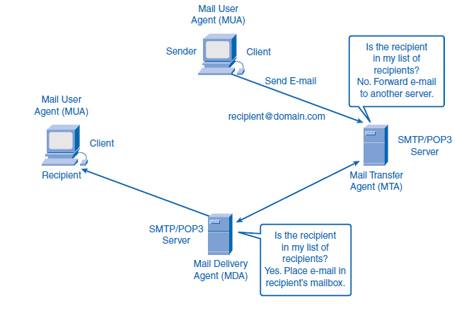
4. E-Mail Services and SMTP/POP Protocols
Outline
The Mail Delivery Agent (MDA) accepts a piece of e-mail from a Mail Transfer Agent (MTA) and performs the delivery. The MDA receives all the inbound mail from the MTA and places it into the appropriate users’ mailboxes. The MDA can also resolve final delivery issues, such as virus scanning, spam filtering, and return-receipt handling. Most e-mail communications use the MUA, MTA, and MDA applications.

Slide 19
5. FTP
Outline
FTP is another commonly used application layer protocol. FTP was developed to allow file transfers between a client and a server. An FTP client is an application that runs on a computer that is used to push and pull files from a server running the FTP daemon (FTPd).
To successfully transfer files, FTP requires two connections between the client and the server: one for commands and replies, and the other for the actual file transfer. The client establishes the first connection to the server on TCP port 21.
This connection is used for control traffic, consisting of client commands and server replies. The client establishes the second connection to the server over TCP port 20.
This connection is for the actual file transfer and is created every time a file is transferred. The file transfer can happen in either direction. The client can download (pull) a file from the server or upload (push) a file to the server.

Slide 20
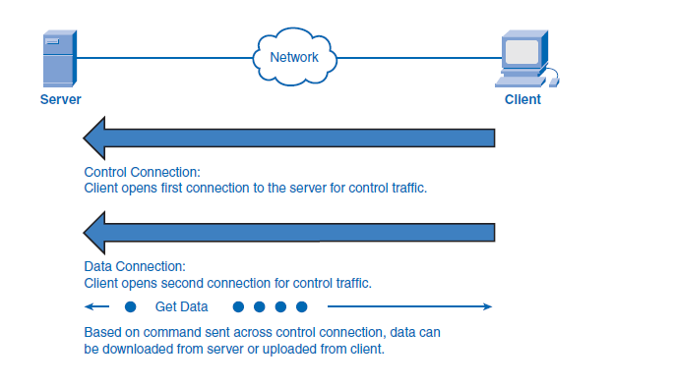
5. FTP
Outline

Slide 21
6. DHCP
Outline
The DHCP enables clients on a network to obtain IP addresses and other information from a DHCP server. The protocol automates the assignment of IP addresses, subnet masks, gateway, and other IP networking parameters.
DHCP allows a host to obtain an IP address dynamically when it connects to the network. The DHCP server is contacted by sending a request, and an IP address is requested. The DHCP server chooses an address from a configured range of addresses called a pool and assigns it to the host client for a set period.
On larger networks, local networks, or where the user population changes frequently, DHCP is preferred. New users might arrive with laptops and need a connection. Others have new workstations that need to be connected. Rather than have the network administrator assign IP addresses for each workstation, it is more efficient to have IP addresses assigned automatically using DHCP.

Slide 22
6. DHCP
Outline
When a DHCP-configured device boots up or connects to the network, the client broadcasts a DHCP DISCOVER packet to identify any available DHCP servers on the network. A DHCP server replies with a DHCP OFFER, which is a lease offer message with an assigned IP address, subnet mask, DNS server, and default gateway information as well as the duration of the lease.
DHCP-distributed addresses are not permanently assigned to hosts but are only leased for a period of time. If the host is powered down or taken off the network, the address is returned to the pool for reuse. This is especially helpful with mobile users who come and go on a network. Users can freely move from location to location and re-establish network connections. The host can obtain an IP address after the hardware connection is made, either through a wired or wireless LAN.

Slide 23
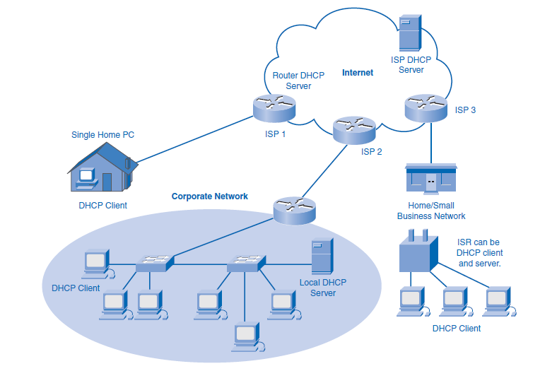
6. DHCP
Outline

Slide 24
6. DHCP
Outline
DHCP can pose a security risk because any device connected to the network can receive an address. This risk makes physical security an important factor when determining whether to use dynamic or static (manual) addressing. Dynamic and static addressing have their places in network designs. Many networks use both DHCP and static addressing. DHCP is used for general-purpose hosts such as end-user devices, and static, or fixed, addresses are used for network devices such as gateways, switches, servers, and printers.
The client can receive multiple DHCP OFFER packets if the local network has more than one DHCP server. The client must choose between them and broadcast a DHCP REQUEST packet that identifies the explicit server and lease offer that it is accepting. A client can choose to request an address that it had previously been allocated by the server.

Slide 25
6. DHCP
Outline
Assuming that the IP address requested by the client, or offered by the server, is still valid, the chosen server would return a DHCP ACK (acknowledgment) message. The ACK message lets the client know that the lease is finalized. If the offer is no longer valid for some reason, perhaps because of a timeout or another client allocating the lease, the chosen server must respond to the client with a DHCP NAK (negative acknowledgment) message. When the client has the lease, it must be renewed prior to the lease expiration through another DHCP REQUEST message. The DHCP server ensures that all IP addresses are unique. (An IP address cannot be assigned to two different network devices simultaneously.)

Slide 26
7. Telnet Services and Protocol
Outline
Long before desktop computers with sophisticated graphical interfaces existed, people used text-based systems that were often just display terminals physically attached to a central computer. After networks were available, people needed a way to remotely access the computer systems in the same manner that they did with the directly attached terminals. Telnet was developed to meet that need. It dates back to the early 1970s and is among the oldest of the application layer protocols and services in the TCP/IP suite. Telnet is a client/server protocol that provides a standard method of emulating text-based terminal devices over the data network. Both the protocol itself and the client software that implements the protocol are commonly referred to as Telnet.

Slide 27
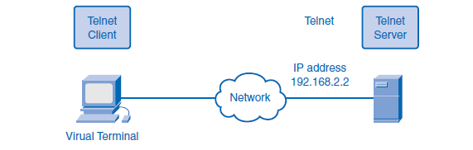
7. Telnet Services and Protocol
Outline
Although the Telnet protocol supports user authentication, it does not support the transport of encrypted data. All data exchanged during a Telnet session is transported as plain text across the network. This means that the data can be intercepted and easily understood. The Secure Shell (SSH) protocol offers an alternate and secure method for server access. SSH provides the structure for secure remote login and other secure network services. It also provides stronger authentication than Telnet and supports the transport of session data using encryption. As a best practice, network professionals should use SSH in place of Telnet, whenever possible.

Slide 28


THANK YOU

